Slide 1


Espousal Clings ❤
A Musician Booking App for a wedding venue

Slide 2
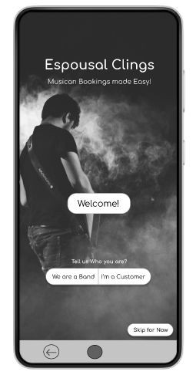


Project overview
The product:
‘Espousal Clings’ app is used to book musicians for a wedding venue. The target users are Wedding Planners, Couples and other event organizers.
Preview of selected polished designs.
Project duration: 1 Month
MAR 2023

Slide 3
Project overview
The problem:
The couples, their parents and Wedding Planners face problems related to pre-booking the musician band, payments, their performances and choices to choose musician to ﬁt their theme and cultural background.
The goal:
To Create a app “Espousal Clings” that connects musicians of diverse abilities and backgrounds to the customers and enabling the customers to pick their preferred musicians based on their budget, theme and also based on the feedback.

Slide 4
Project overview
My role:
UX designer, UX researcher.
Responsibilities:
User research, wireframing, prototyping, testing.

Slide 5

Understanding
the user
User research
Personas
Problem statements
User journey maps

Slide 6


User research: summary
After Conducting the Secondary Research, The End Users are found to be The Bride and Groom, Their Parents and a Wedding planner.
I assumed that users are facing problems such as ﬁnding the best musician band nearby their town and are also doubted on their overall performance quality.
But, after the research, I found that users also needs assistance in comparing the price of the two bands and also wants to know their past performance reviews to make better decisions.

Slide 7
User research: pain points
1
Hard to Compare
2
Unable to trust
3
Tiring to Find
4
Time consuming
It’s hard to compare the two musician bands performances and also their prices.
Cannot easily trust that they will come on time and also provide their best performance.
It’s tiring to locate the best musicians around the town and uncertain about their availability.
It is time consuming to consult the band
in-person and to pre book them.

Slide 8
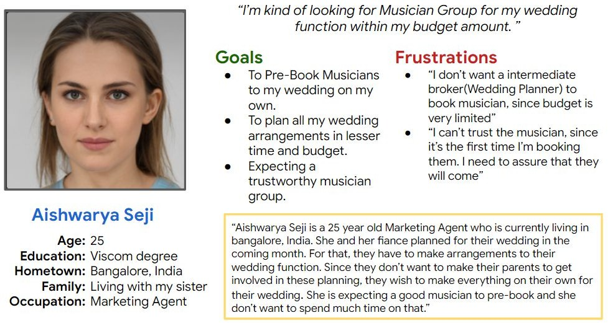
Persona: Aishwarya Seji
Problem statement: Aishwarya Seji is a marketing agent and currently planning her wedding
who needs to quickly book the best musician band for her ceremony under her budget
because she is busy on planning other tasks and don’t want to spend much time and money on the intermediates.

Slide 9
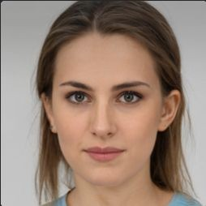
“I’m kind of looking for Musician Group for my wedding funcīion wiīhin my budgeī amounī. ”
Goals
To Pre-Book Musicians to my wedding on my own.
To plan all my wedding arrangements in lesser time and budget.
Expecting a trustworthy musician group.
Frustrations
“I don’t want a intermediate broker(Wedding Planner) to book musician, since budget is very limited”
“I can’t trust the musician, since
it’s the first time I’m booking them. I need to assure that they will come”
Aishwarya Seji
Age: 25
Education: Viscom degree
Hometown: Bangalore, India
Family: Living with my sister
Occupation: Marketing Agent
“Aishwarya Seji is a 25 year old Marketing Agent who is currently living in bangalore, India. She and her fiance planned for their wedding in the coming month. For that, they have to make arrangements to their wedding function. Since they don’t want to make their parents to get involved in these planning, they wish to make everything on their own for their wedding. She is expecting a good musician to pre-book and she don’t want to spend much time on that.”

Slide 10
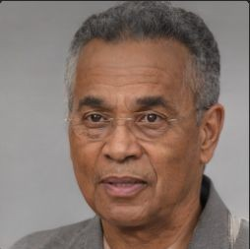
“I wanī īo pick up īhe besī musician for my clienī based on īheir budgeī & preferences wiīh less efforī, and more choices īo maīch īheir īasīe of music.
Goals
To book musicians with minimal effort.
To ensure that they
produce a good experience in the wedding venue.
To make his planning much suitable to their
client’s preference.
Frustrations
“It is tiring to continuously search for different musician bands across the town”
“I cannot trust the new
musicians on their performance.”
“I am unable to suggest the same set of musicians to my different clients”
Aravind Rajkumar
Age: 43
Education: Sociology Degree
Hometown: Coimbatore, India
Family: Living with my wife
Occupation: Wedding Planner
Aravind Rajkumar is a middle-aged man, who is independently working as a wedding planner to their clients. Nowadays, he is consulting clients from diverse backgrounds with different way of conducting wedding according to their cultures. He is kind of spending much on planning the arrangements for the wedding. But he has a limited connections to musician groups. He is expecting multiple choices to explore and match to their clients with their preferred theme and on budget. Also to book with less effort.

Slide 11
USER STORY
Aishwarya Seji
As a/an
Young adult planning for my wedding ceremony
type of user
I want to directly Pre-book the best musician group to my wedding ceremony under
my budget
action
.
so that
I can pick my preferred theme and also save money & time on not spending
much to the intermediates
benefit

Slide 12
USER STORY
Aravind Rajkumar
As a/an
Experienced wedding planner
type of user
I want to Pick up the best suited musician groups to my clients based on their
preferred theme & budget
action
.
so that
I can effortlessly organize the wedding ceremony & provide my clients a
memorable experience
benefit

Slide 13
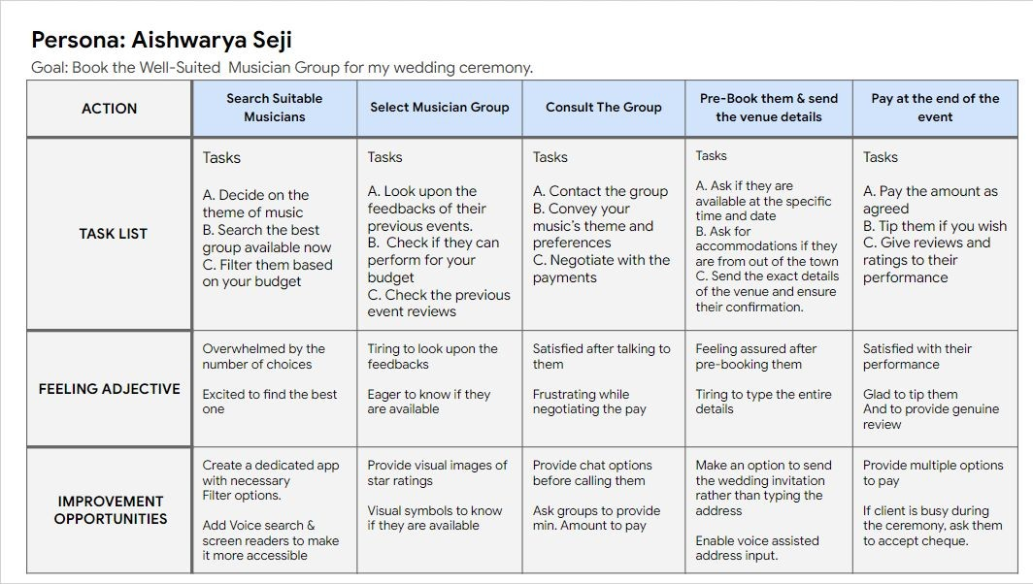
User journey map
Goal : To Book the
well-suited Musician band for the wedding ceremony.

Slide 14
Persona: Aishwarya Seji
Goal: Book the Well-Suited Musician Group for my wedding ceremony.
ACTION | Search Suitable Musicians | Select Musician Group | Consult The Group | Pre-Book them & send the venue details | Pay at the end of the event
 | Tasks | Tasks | Tasks | Tasks | Tasks
TASK LIST | Decide on the theme of music Search the best group available now Filter them based on your budget | Look upon the feedbacks of their previous events. Check if they can perform for your budget Check the previous event reviews | Contact the group Convey your music’s theme and preferences Negotiate with the payments | Ask if they are available at the specific time and date Ask for accommodations if they are from out of the town Send the exact details of the venue and ensure their confirmation. | Pay the amount as agreed Tip them if you wish Give reviews and ratings to their performance
 | Overwhelmed by the number of choices | Tiring to look upon the feedbacks | Satisfied after talking to them | Feeling assured after pre-booking them | Satisfied with their performance
FEELING ADJECTIVE | Excited to find the best one | Eager to know if they are available | Frustrating while negotiating the pay | Tiring to type the entire details | Glad to tip them And to provide genuine review
IMPROVEMENT OPPORTUNITIES | Create a dedicated app with necessary Filter options. Add Voice search & screen readers to make it more accessible | Provide visual images of star ratings Visual symbols to know if they are available | Provide chat options before calling them Ask groups to provide min. Amount to pay | Make an option to send the wedding invitation rather than typing the address Enable voice assisted address input. | Provide multiple options to pay If client is busy during the ceremony, ask them to accept cheque.

Slide 15


PROBLEM STATEMENT
Aishwarya Seji
is a/an
Marketing Agent and she is about to marry
user name user characteristics
who needs
A Musician Booking App for her Wedding Ceremony
user need
because
She don’t want to spend much money on agents and to book within her budget
.
insight
2018 | Confidential and Proprietary

Slide 16
GOAL STATEMENT
Our
Musician Booking App
will let users
To consult and pre-book musician groups
product (what) perform specific actions (what)
which will affect
The customers who are looking for musicians for their wedding ceremony
describe who the action will affect (who)
_{by} Providing a way to book musicians of their best-suit based on their preferences and budget.
.
describe how the action will positively affect users (why)
We will measure effectiveness by
Analyzing the seasonal appointments and booking rates.
.
describe how you will measure the impact

Slide 17
User Flow : Musician Booking App
Open App
Home Page
Search with filters
List of Bands
Select Band
Profile Page
My Profile
Consult
Wallet
N Y
Pre Book With Venue Details
Pay
N Y
Receipt With Confirmation
Payment Status

Slide 18
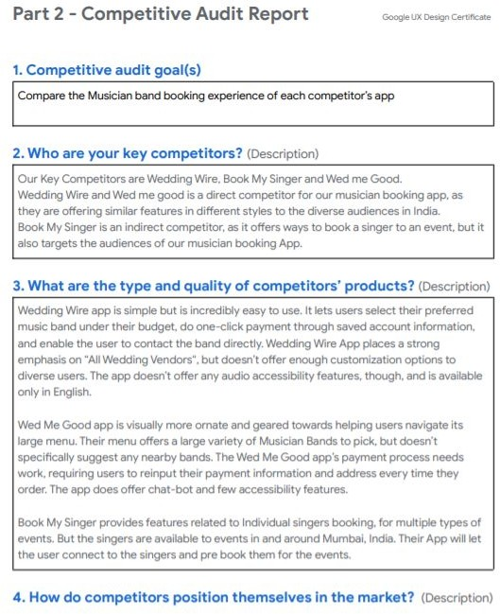
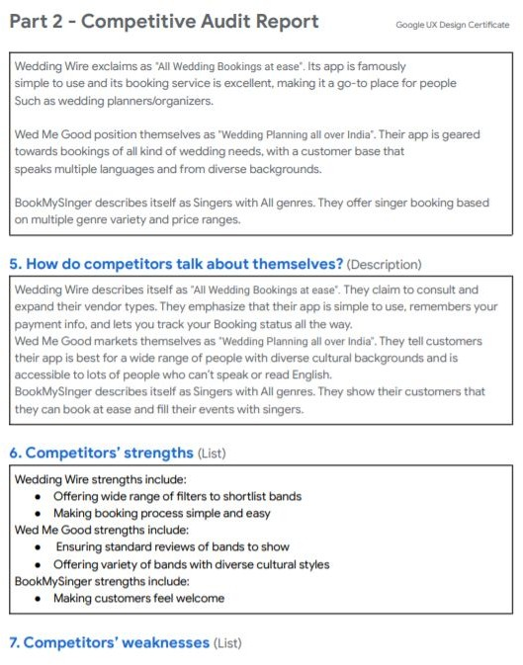
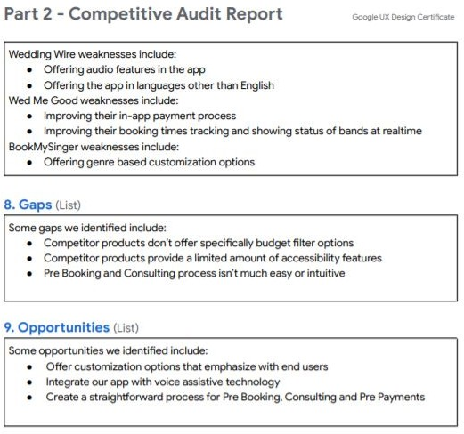
Competitive Audit & Audit Repoit

Slide 19
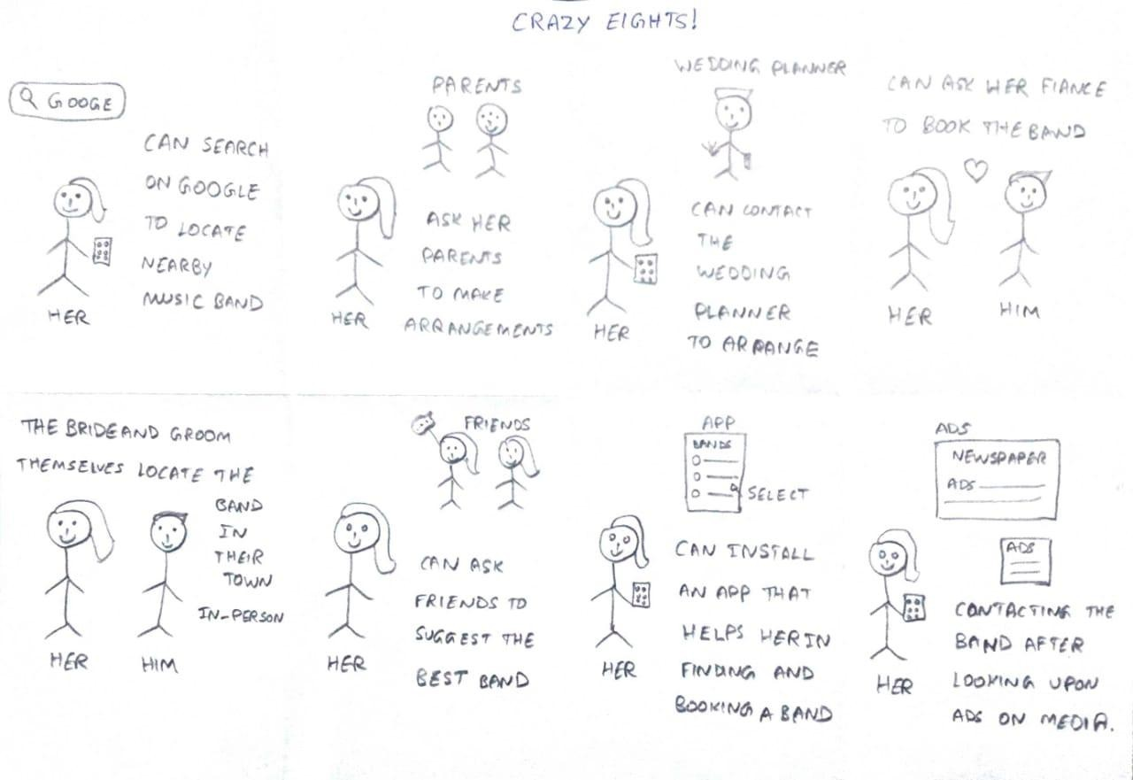
crazy Eights : Ideas

Slide 20
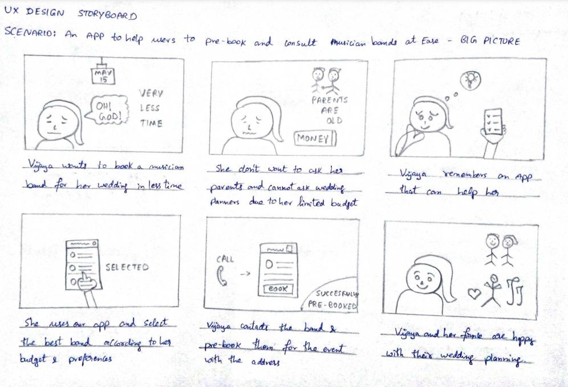
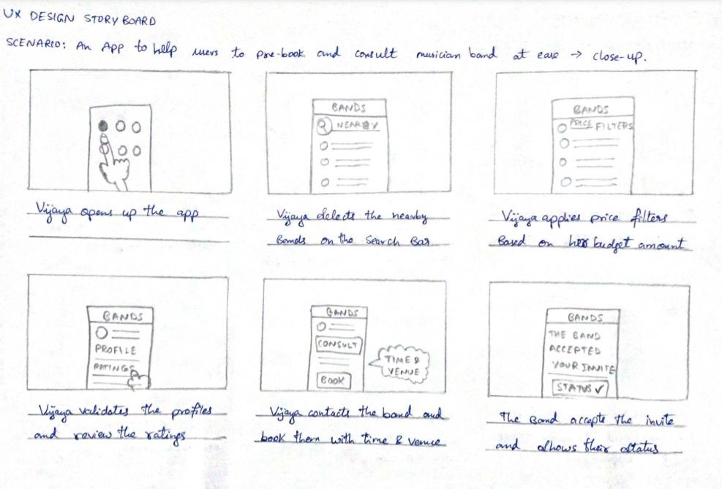
StoryBoards - Big Picture & Close Up

Slide 21

Paper wireframes
Digital wireframes
Low-ﬁdelity prototype
Usability studies
Starting the design

Slide 22
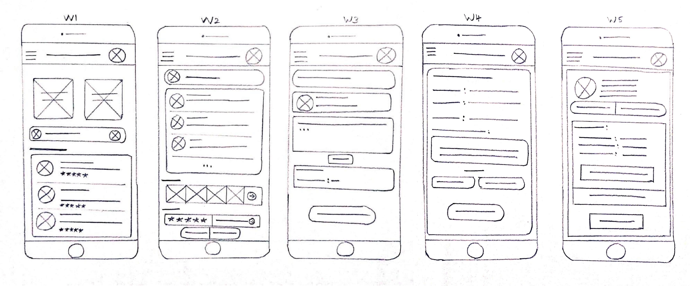
Paper wireframes
Image of paper wireframes including ﬁve diﬀerent versions of the same screen and one image of the new, reﬁned version

Slide 23
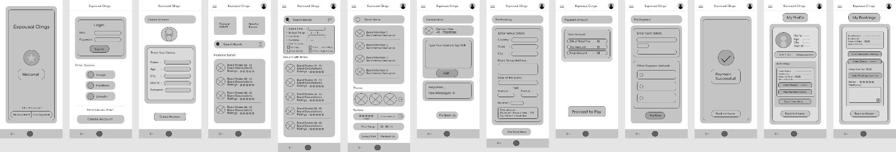
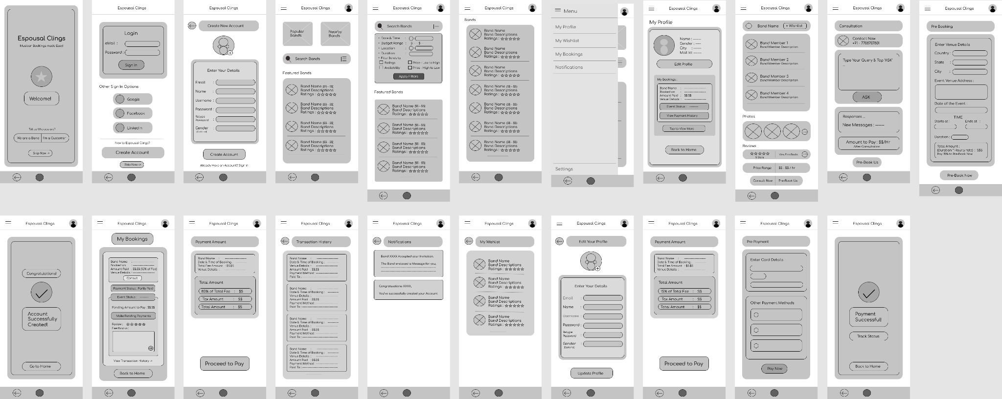
Digital wireframes

Slide 24
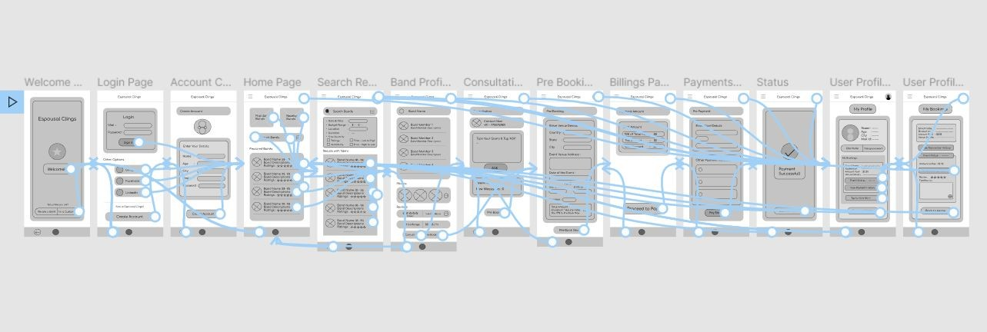
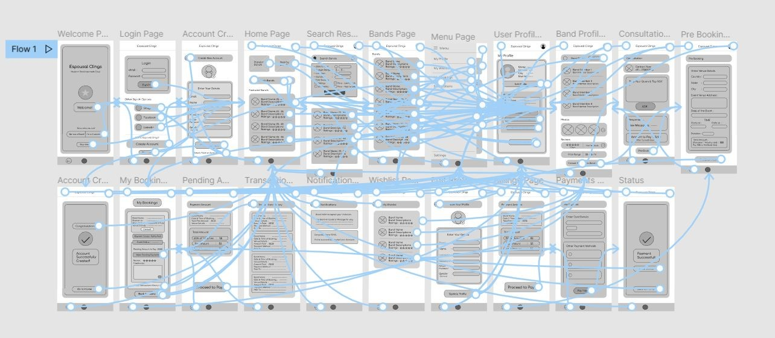
Low-ﬁdelity prototype
Prototype Link

Slide 25
Reﬁning the design
Mockups
High-ﬁdelity prototype
Accessibility

Slide 26
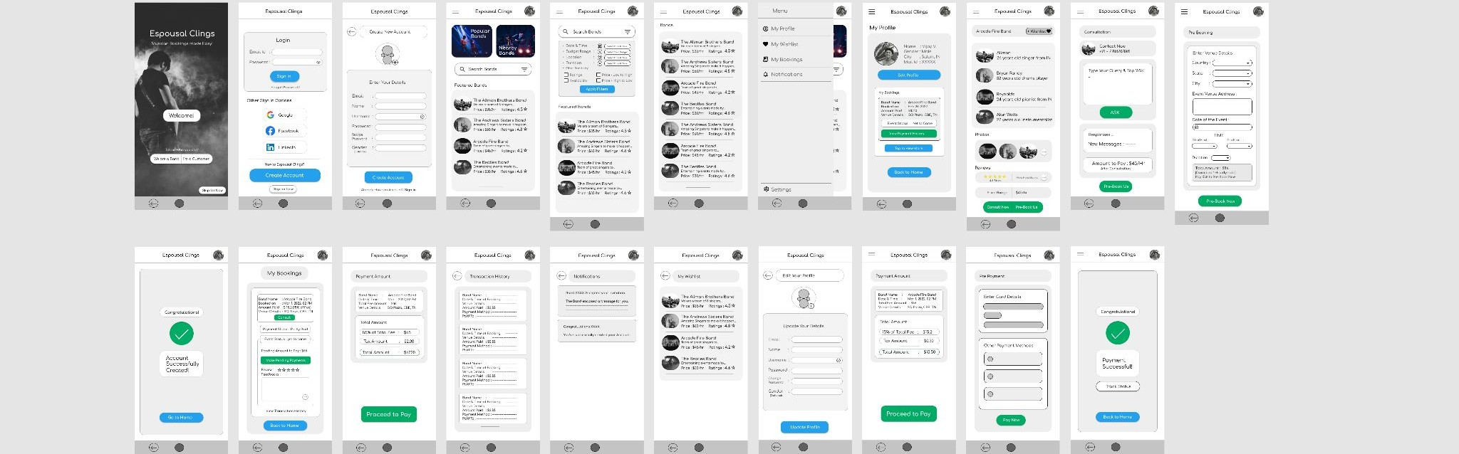
Mockups
Main mockup screen for display
Main mockup screen for display
Main mockup screen for display
Main mockup screen for display

Slide 27
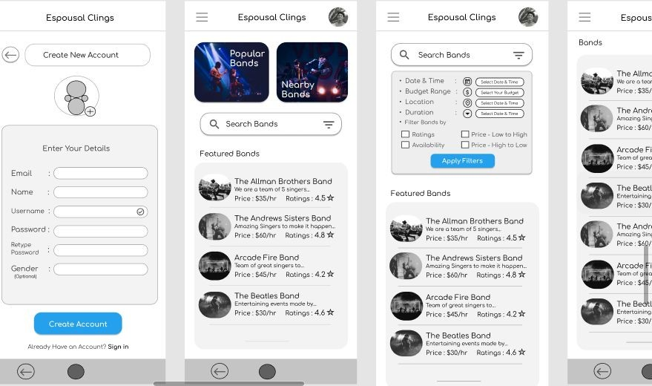
High-ﬁdelity prototype
Screenshot of prototype with connections or prototype GIF
Link

Slide 28
Accessibility considerations
1 2
3
Screen Reader Compatibility:
Color Contrast:
Keyboard Accessibility:
Many users with visual impairments rely on screen readers to access content on their devices. Therefore, it is important to ensure that the app is compatible with screen readers, and that all content and controls are labeled properly to allow for easy navigation and use.
The app should have high color contrast to ensure that users with visual impairments can read and navigate the app with ease. This means that the color scheme should avoid low-contrast color combinations and instead use high-contrast color combinations that make it easy.
It is important to ensure that all functions of the app can be accessed using only a keyboard. This means that users should be able to navigate the app, select options and submit forms using the tab, arrow, and enter keys

